Slide 1
SysML
A subset of OML designed for complex systems engineering
By Anthony redamonti

Slide 2
Why use modeling languages?
Systems are becoming increasingly complex and are rapidly changing. Modeling languages are needed to decrease response time to rapidly evolving specifications.
Improved team communication:
A picture says 1,000 words. Modeling languages help illustrate the complex interactions between software components in a system.
Architectural + Behavioral modeling:
System Structure + Class Hierarchy
Interaction with user
How processes + threads interact with each other
Provides Traceability: the team’s progress is displayed and updated in real-time. Proves that the system requirements have been met through test case validation.

Slide 3
What is sysml?
A subset of UML.
It’s a graphical modeling language targeting model-based systems engineering: Integration of software + hardware.
Created by members of INCOSE and the Object Management Group (OMG).
3 additional diagram types not included in UML: Structural, Cross-Cutting, and Behavioral.

Slide 4
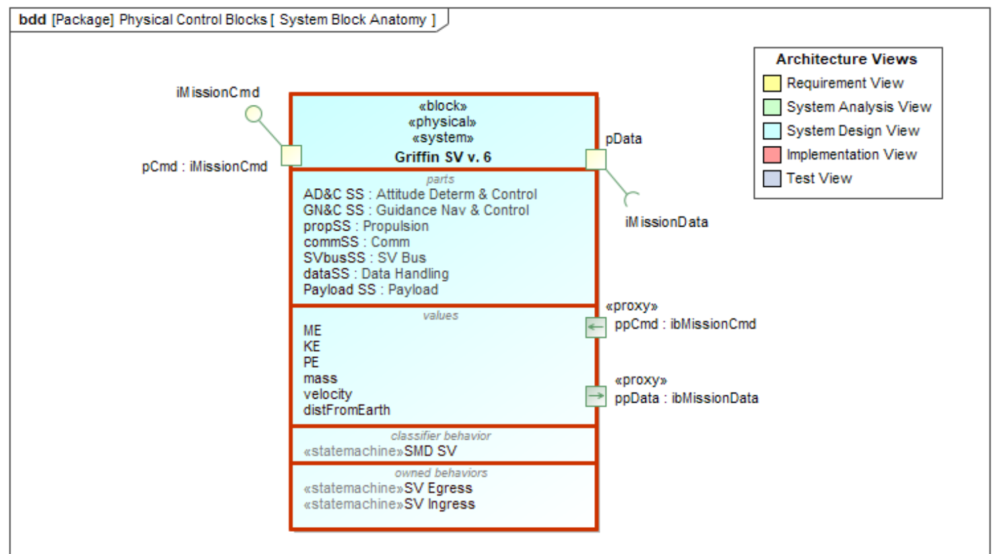
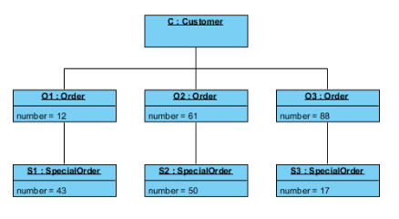
Structural Diagrams (Sysml)
Block Definition Diagram (BDD): represent system components (software or hardware), their interfaces and relationships.
Compartmentalizes a unique ID for the block and the requirement(s) it fulfills.
Object Diagrams (UML)
Encapsulates an object in a class diagram, showing the state of an object at a point in time.

Slide 5
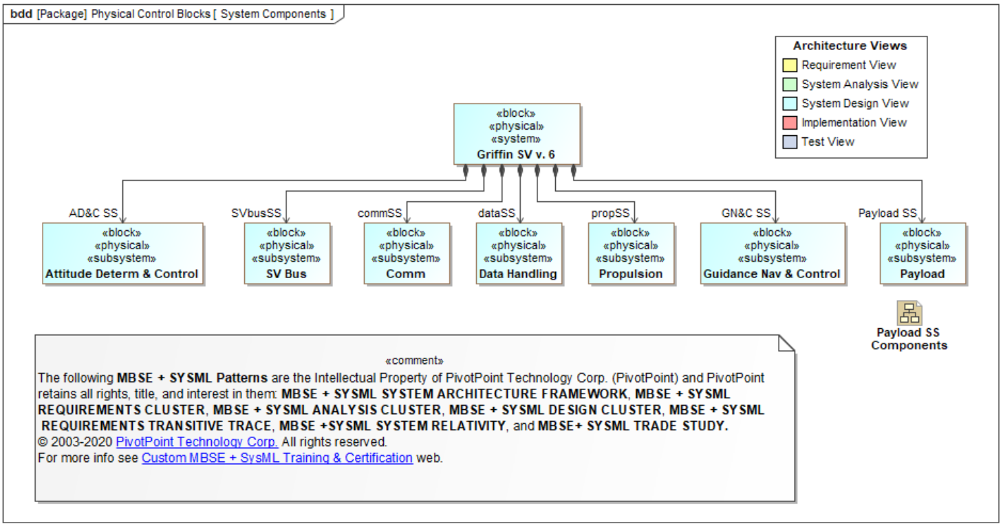
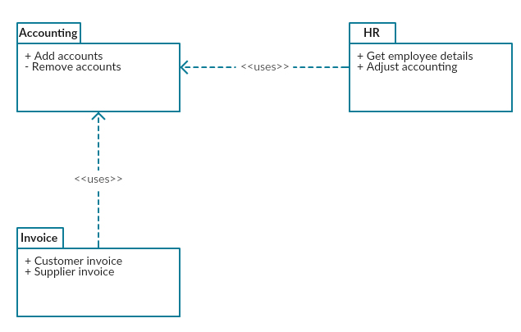
SysML IBD vs UML package
Internal Block Diagram (IBD): Illustrates the encapsulated components inside a block.
UML Package diagram displays the relationships between packages in a system in a more general way.

Slide 6
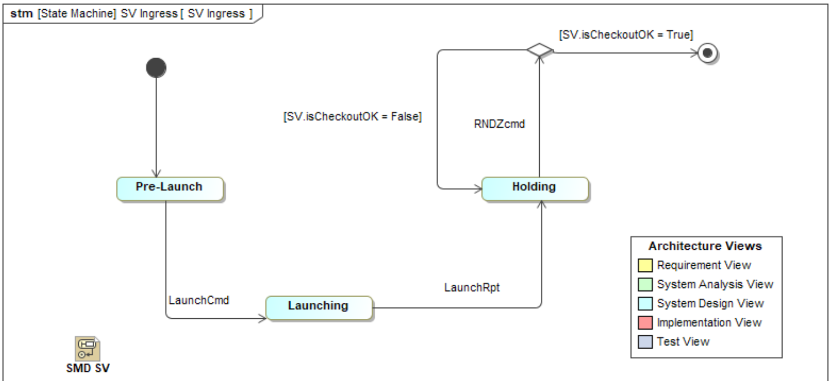
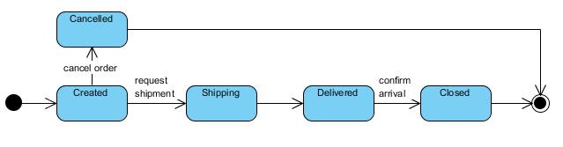
Sysml Behavioral diagrams (SMD)
State Machine Diagram (SMD): a dynamic diagram that illustrates the various states an object can have during its life in the system.
UML sMD
Missing the Architecture View tools: Requirement View, System Analysis View, System Design View, Implementation View, and Test View.

Slide 7
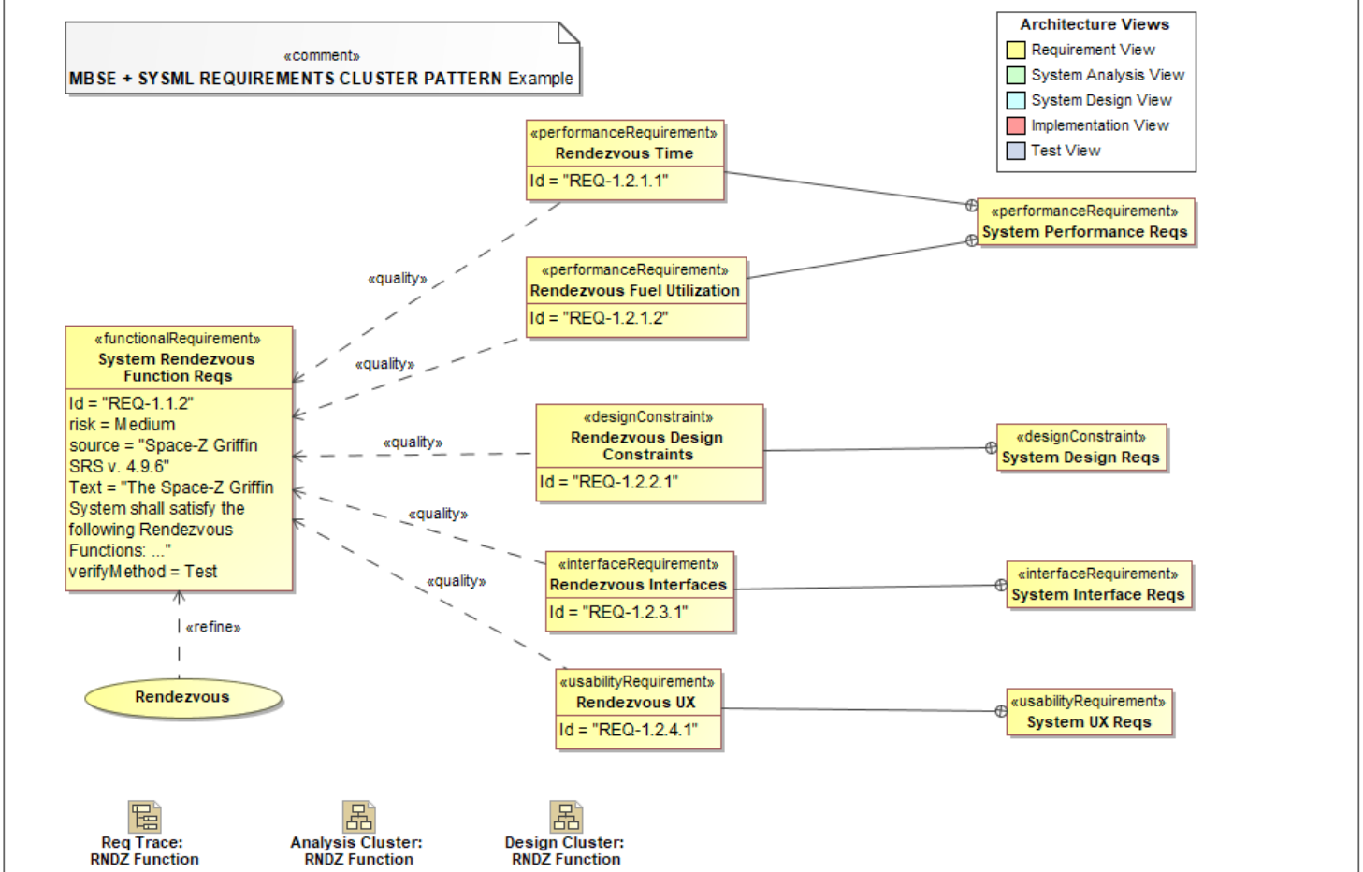
NEW Cross-cut diagrams (Not in UML)
Requirement Diagram (REQ): a structural diagram that illustrates the relationships between requirements, models that satisfy them, and test cases that verify them.

Slide 8
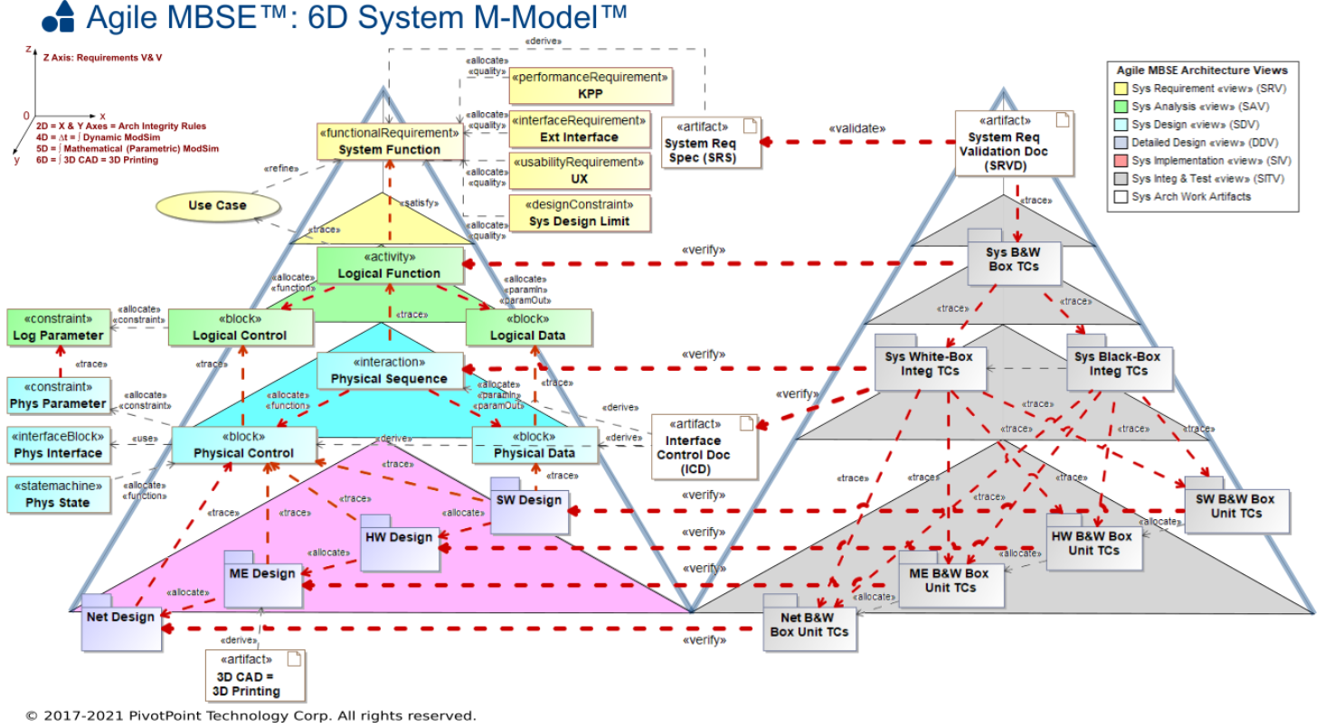
SYSML integration with Agile MBSE
One key improvement from UML to SysML is the integration of Agile Model-Based Systems Engineering (MBSE).
Scalable
Simulatable
Pattern-based for reuse
Test-driven

Slide 9
Companies using sysml today
Lockheed Martin Corporation
ARTiSAN Software Tools
Telelogic Systems
EmbeddedPlus
IBM Software Group

